Slide 1
Project 1: Protinex
Market Opportunity Analysis
Segmenting, Positioning and Branding

Slide 2
Learner Name: Jaismine Kaur

Slide 3
Q1. Based on the details shared in the video, come up with various criteria based on which Protinex could do segmentation, targeting and positioning. Additionally, provide your rationale for it. Mention at least three criteria for segmentation. (Word Limit: 200 words for your entire answer) (Note: Only the segmentation part of slide 1 will be graded in this question.)

Slide 4
Answer 1
Segmentation | Geographic: Tier 1-2 cities Demographic: Every age group and gender (Protinex Grow, Junior, Original, Diabetes Care, Mama), upper middle class to upper class groups Psychographic: worried about diet as well as fitness, may suffer from triggers mentioned like fatigue, busy lifestyle, probably more effective towards the large vegetarian segment of India - from the absence of meat based high protein diet, conscious about health Behavioural: Daily usage on a continual basis for health and balanced diet
Targeting | Differentiated strategy for different groups, their ages and needs (fitness, lack, mothers, diabetes). Premium in HFD category with high quality and low competition in the quadrant. High nutritional value catering to the diets of Indians who lack protein in their general daily intake.
Positioning | A premium, highly nutritional brand to be associated with general daily intake and direct consumer consumption instead of a problem solution product.

Slide 5
Q2. Based on the information given in the video, how would you plot Protinex on the perceptual map? Have you seen any shifts in the last few years? (Word Limit: 120 words) You can follow these steps: What parameters can you differentiate on? Mention the 2 most important factors with regards to HFDs. These will act as the axes for your perceptual map. Create a perceptual map for the HFD players in India (You will have to show Protinex + competitors in the HFD sector). Add the image of your map in the solution ppt.

Slide 6
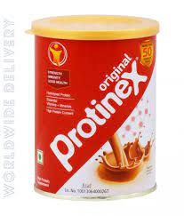
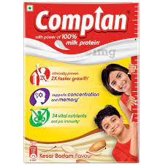
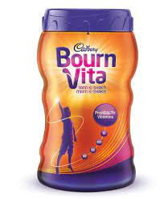
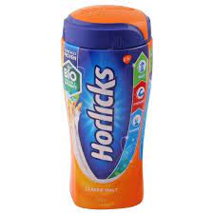
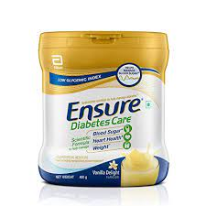
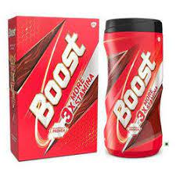
Answer 2
Shifts:
Illness to wellness
Reactive to proactive
Pharmacy to trade stores
(doctor prescribed problem solution brand
to direct to consume brand)
High nutrition
Budget
premium
low nutrition

Slide 7
Q3. Drawing insights from what you saw in the video, devise a positioning statement for Protinex. (Word Limit: 120 words) As a recap, the framework of a positioning statement is given below: ‘For [target market], Protinex is [frame of reference/competitive set] that [key benefits, unique value claim] because [reasons to believe, evidence]’.

Slide 8
Answer 3
For all ages and needs, Protinex is for the tier-1-2 high income individuals and families that lack of protein rich diets in thei general intakes and can be solved with the regular nutrition rich consumption of Protinex. People who are in general diet conscious or suffer from triggers like fatigue, have a health condition, or want to be more fit and consume protein rich diet for muscles, or even new mothers, Protinex is a direct-to-consumer brand with a high prescription rate by doctors as well. The shift towards proactive and wellness state from reactive and illness has been kept in mind while trying to educate the general population of India about the protein deficient diets and general deficiency of it amongst Indians.

Slide 9
Q4. Build your marketing mix to help Protinex shift from a prescription-based brand, to an everyday nutrition brand. You will have to mention the rationale behind each of these. As a recap, the 4Ps of marketing — Product, Price, Place, and Promotion — are distinct factors that marketers can influence in order to create a meaningful product or service and market it to a defined audience. Note: Please draft at least 30 -70 words for each of 4Ps.

Slide 10
Answer 4
Product: highly nutritional, daily consumption, versatile offerings for diverse age and nutritional need segments, for general public with high income
Price: Premium brand with high value and high price, made for upper class but for daily consumption. The price can be backed by claims as the perceived value increases, yet can be moderated to be more eligible for daily use and regular purchase compared to other brands. The product can be diversified to fit the dietary need of middle class as well.
Place: tier1-2, General trade stores, supermarkets, and online
Promotion: Social media diet influencers, direct marketing, sales promotion, online campaigns, emotional and rational advertising

Slide 11
Q5. Now that you have finalised the marketing mix for Protinex, you have to create a digital marketing go-to strategy. You can use the digital marketing framework you learnt in DM Channels and Metrics module. You will have to identify the digital content, digital devices, digital channels, and digital metrics to track for Protinex, with the rationale behind each.

Slide 12
Answer 5
Digital Content: Information about various protinex offerings for all age groups and their needs and the awareness of the deficiency in general intake. (blogs, ,websites promotion, emotional and informational digital adverts)
Digital Devices: Phones, Tablet , Computer (money spent most)
Digital Channels: SEM for awareness, SEO for top result, display marketing for bounced leads, personalized Email marketing and remarketing for purchase stage Company Website, amazon, flipkart, reviews
Digital Metrics: visits, likes, bounce rate, demographics,

